Slide 1

Automation Testing Capstone Projects
Comprehensive API and UI Testing Frameworks Using Python, Pytest, and Robot Framework

Slide 2
Project Overview
Foodie App
REST API testing framework across 18 endpoints —manual testing via Postman, automated with Pytest and Robot Framework
E-Commerce Platform
End-to-end UI automation with dual frameworks —Pytest (Page Object Model) and Robot Framework(keyword-driven)

Slide 3

Agenda
What We'll Cover
Foodie App - REST API Testing
E-Commerce - UI Automation Testing
Frameworks & Tools
Key Achievements
Team & Closing

Slide 4
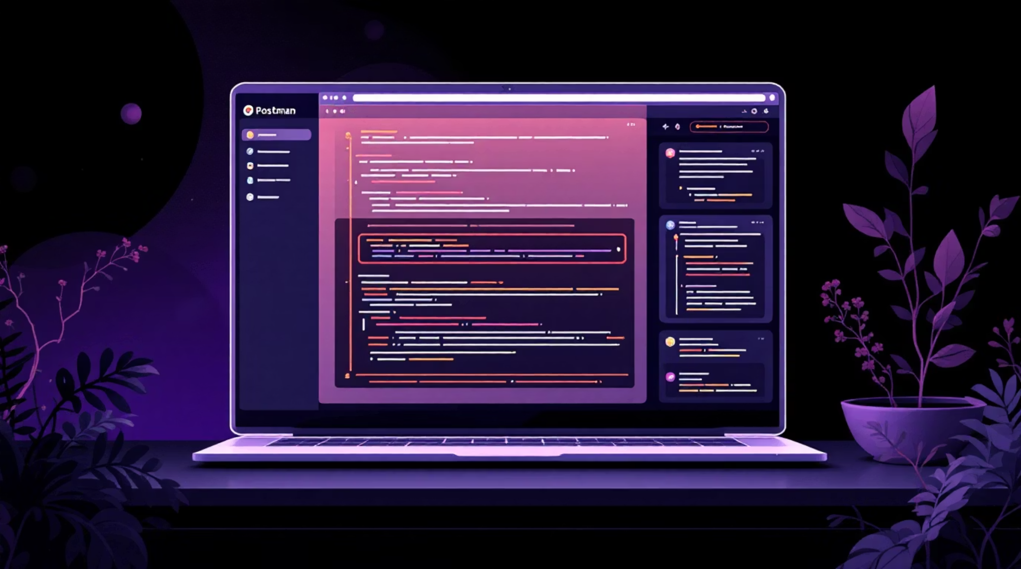
Foodie App: REST API Testing Framework
Technology Stack
Python Flask for RESTful backend development
Postman for comprehensive manual API testing
Pytest with requests library for automation
Robot Framework with RequestsLibrary
JSON schema validation and fixtures
Implements 18 endpoints across Restaurant, Dish, User, Admin, and Order modules following REST principles.

Slide 5
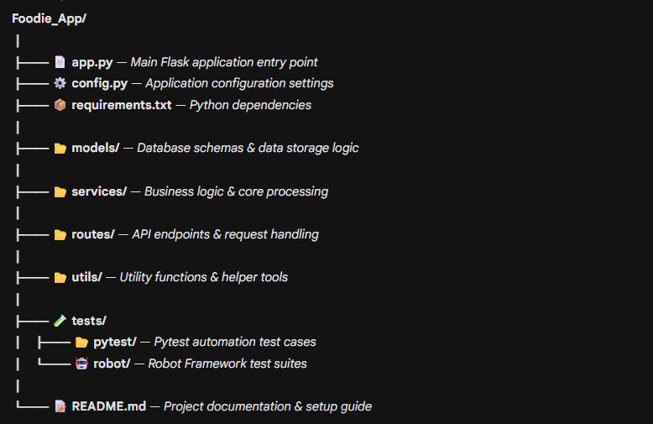
Foodie App: Project Structure

Slide 6
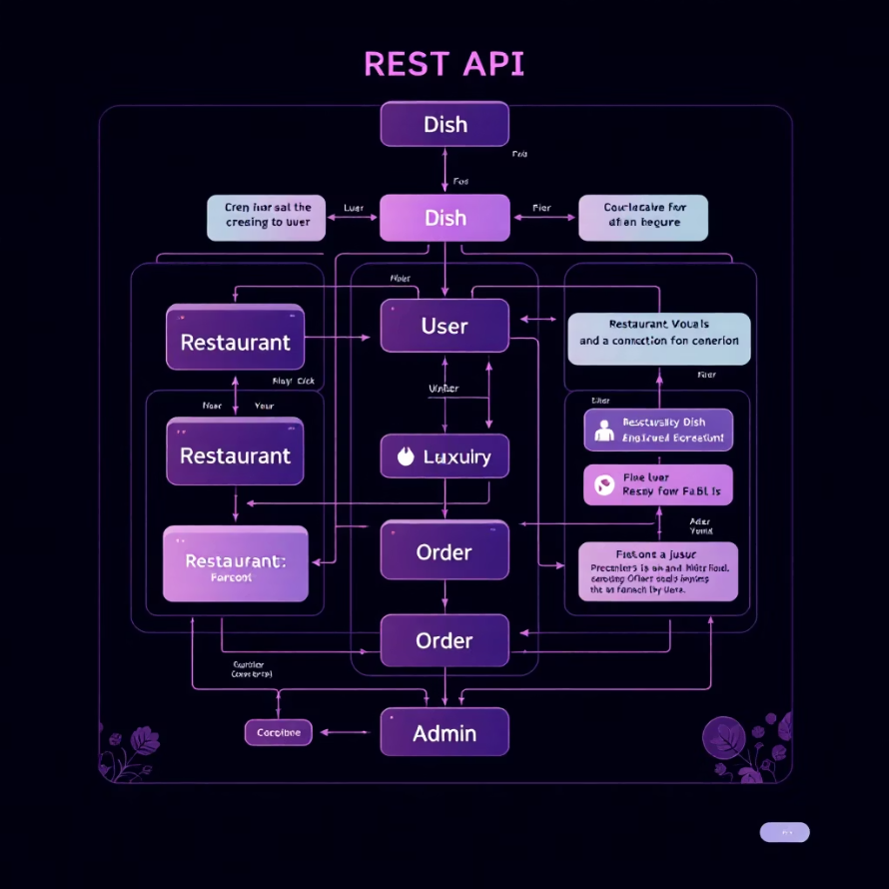
Foodie App: API Modules
18 Endpoints Across 5 Modules
Restaurant Module (4 endpoints)
Register
Update
Disable
View
Dish Module (4 endpoints)
Add
Update
Toggle
Delete
User Module (3 endpoints)
Register
Search
Rate
Order Module (2 endpoints)
By Restaurant
By User
Admin Module (4 endpoints)
Approve
Disable
Feedback
Orders

Slide 7

Foodie App: Manual Testing with Postman
Postman Testing Coverage
18 API endpoints tested manually
Request/response validation
Status code verification
JSON payload testing
Error scenario validation
Collection organization by module

Slide 8
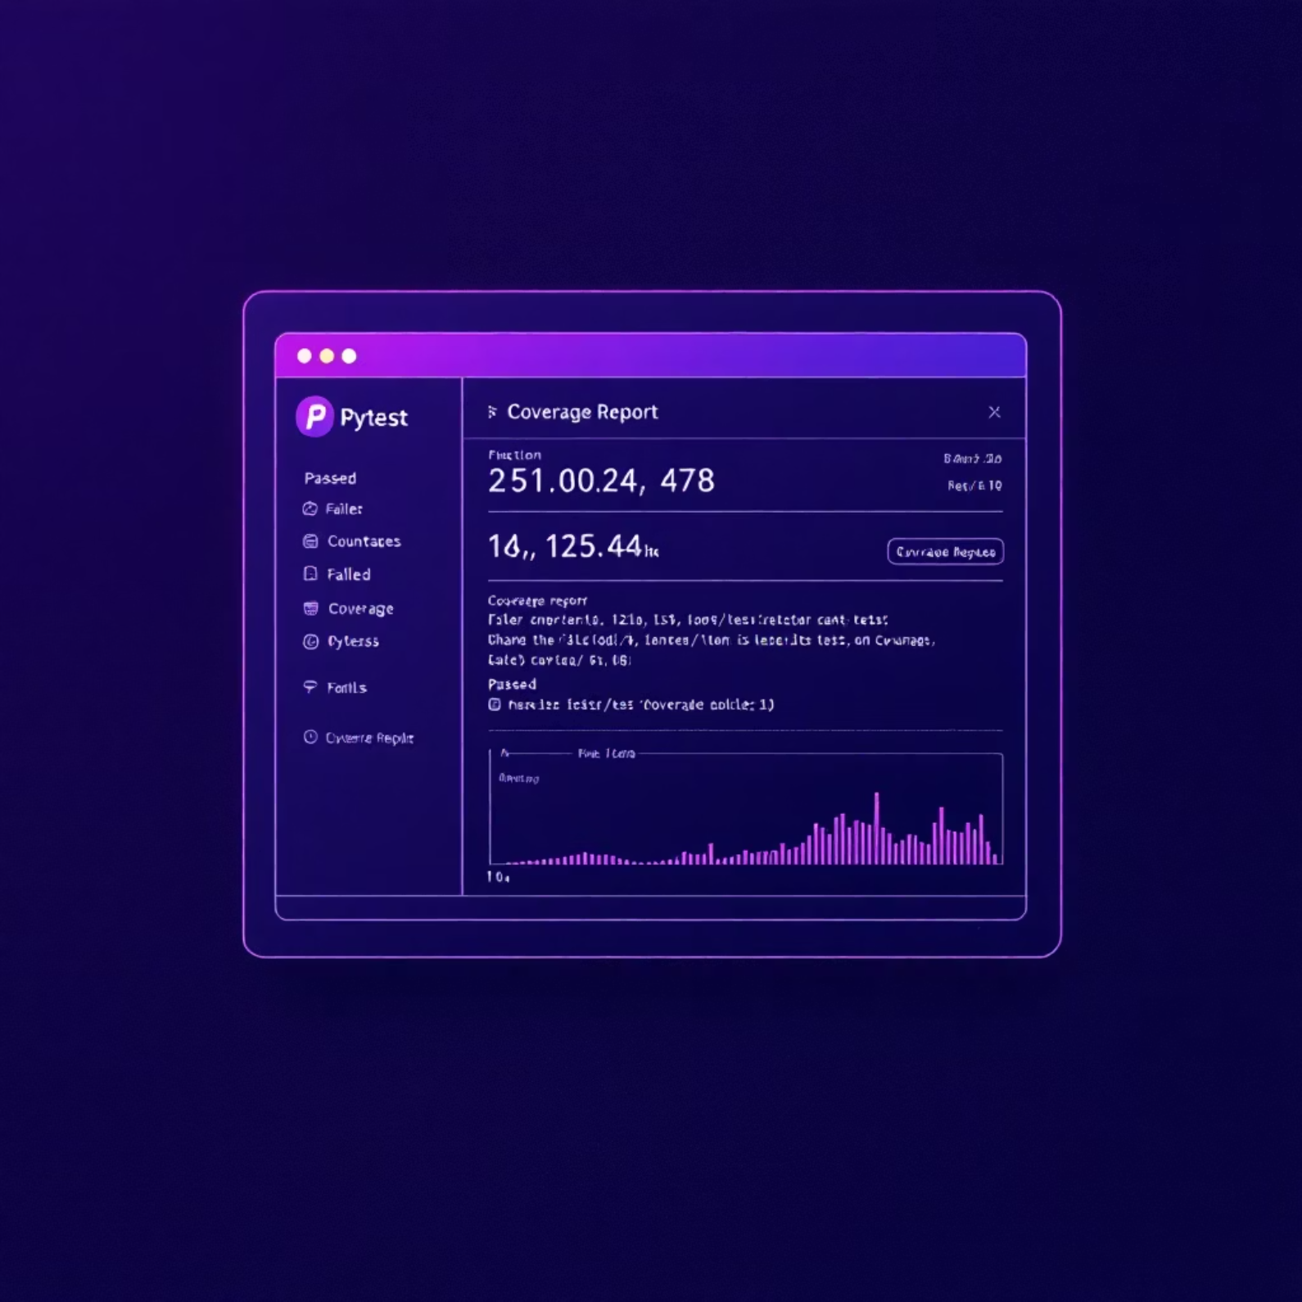
Foodie App: Pytest Automation
Pytest Features
Requests library for HTTP calls
Fixtures for setup/teardown
Parameterized test scenarios
JSON schema validation
Status code assertions
Response body validation
Integration flow testing

Slide 9
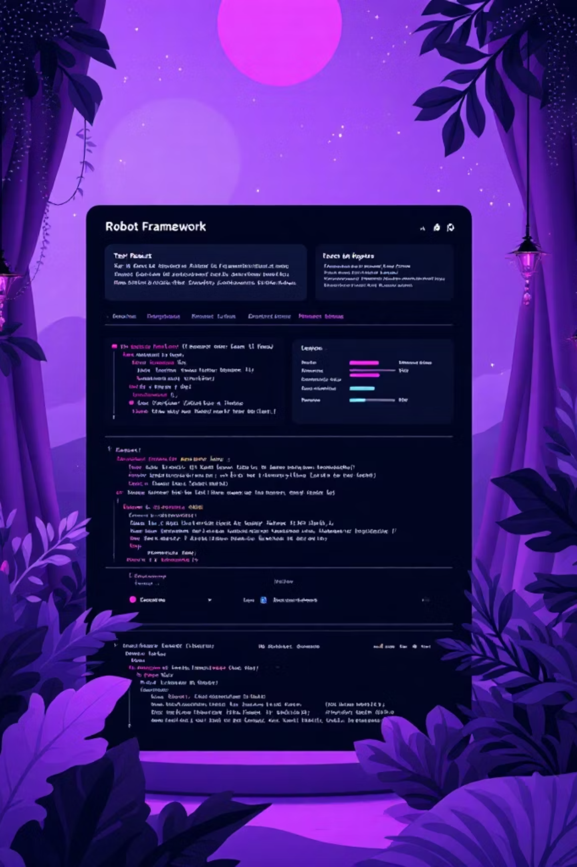
Foodie App: Robot Framework Testing
Robot Framework Advantages
Requests Library for API testing
Keyword-driven test design
Data-driven test cases
Business-readable syntax
HTML test reports with logs
Integration flow testing
Non-technical stakeholder friendly

Slide 10
Foodie App: Testing Approach
Manual → Automated
Robot Framework (Automated)
Postman (Manual)
Pytest (Automated)
API endpoint testing
Request/response validation
Status code verification
Foundation for automation
Requests library
Fixtures & parameterization
JSON schema validation
Coverage reports
Keyword-driven approach
Business-readable syntax
HTML test reports
Non-technical friendly

Slide 11
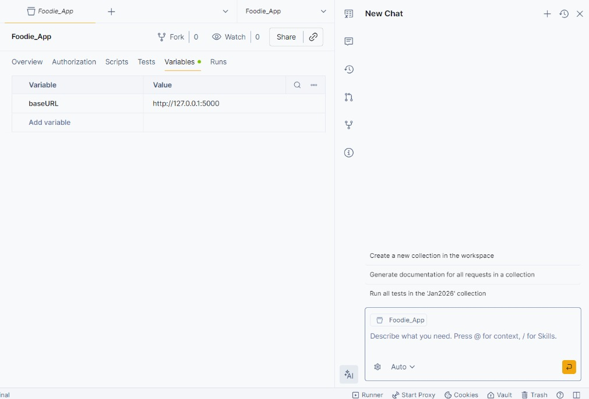
Setting the Variable

Slide 12
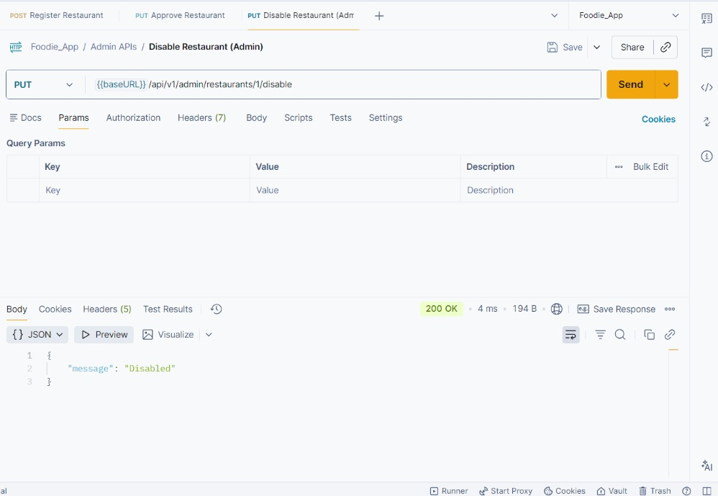
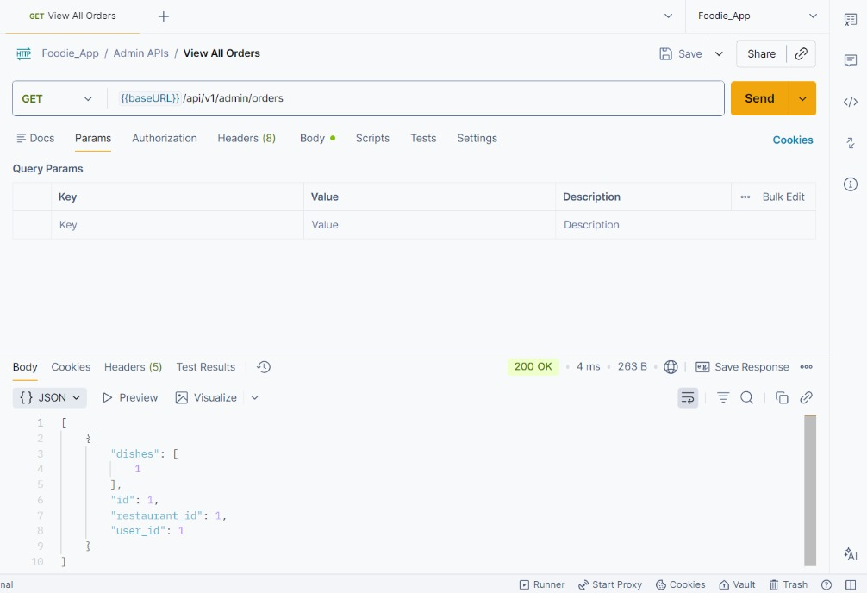
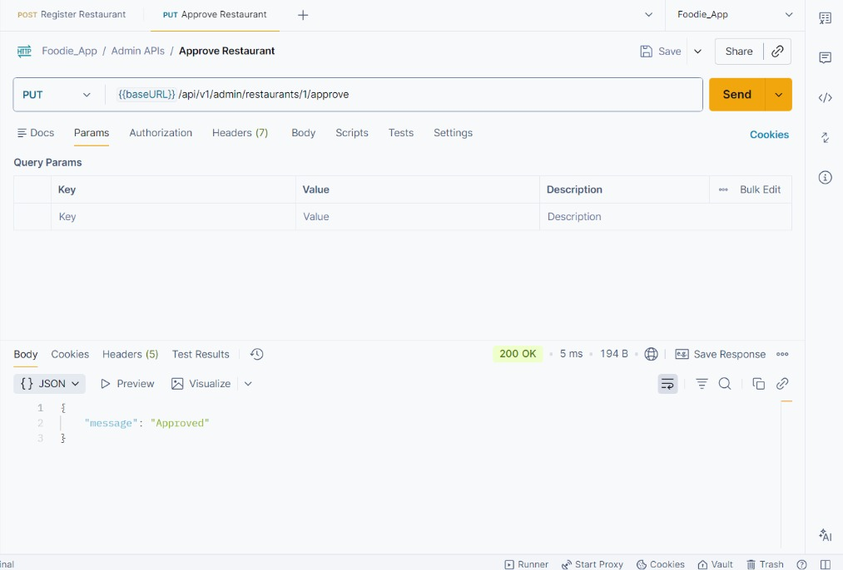
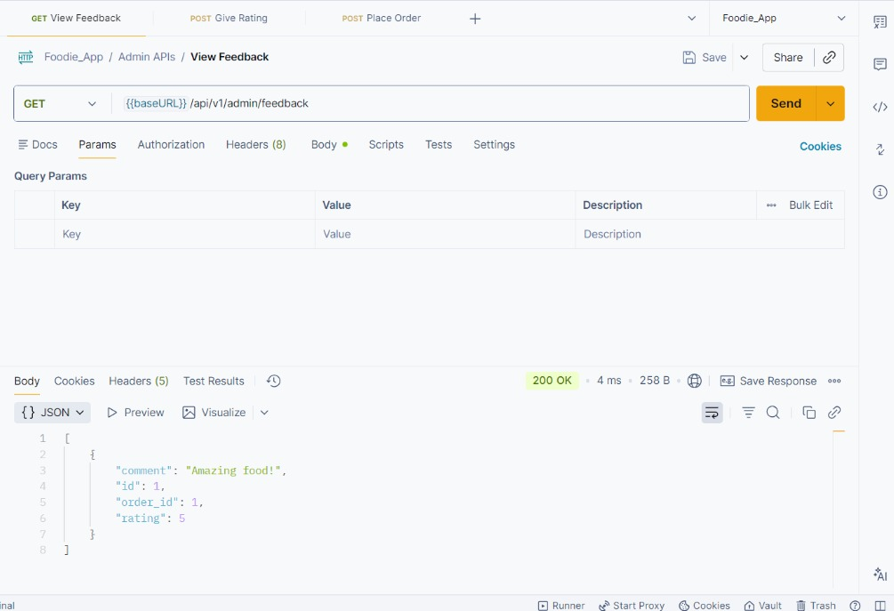
Disable Restaurant(Admin)
View All Orders
Admin Api's
Approve Restaurant
View Feedback

Slide 13
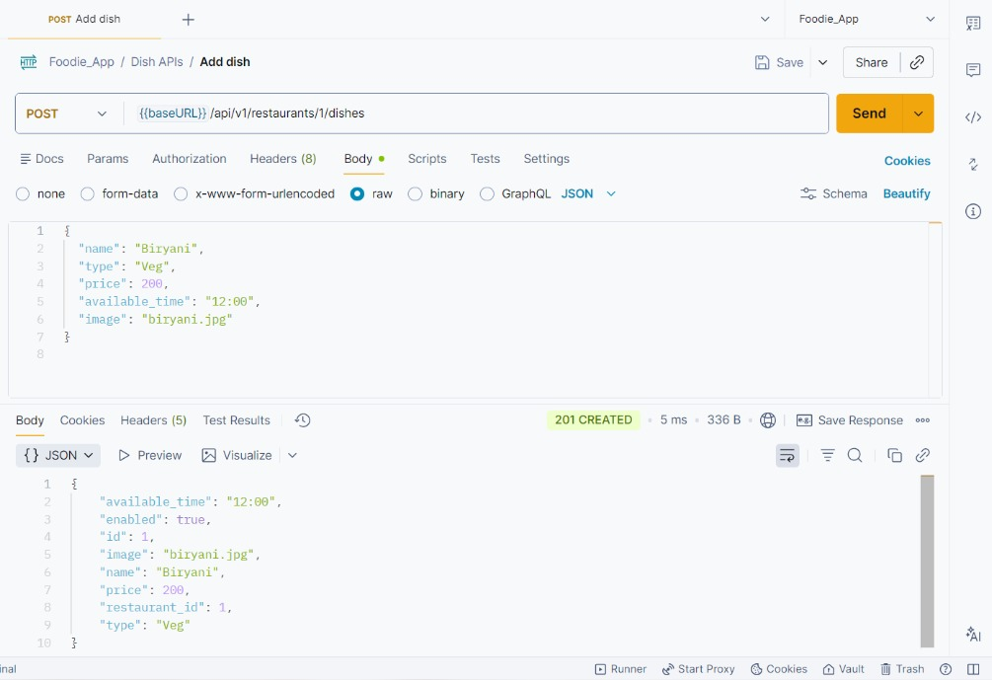
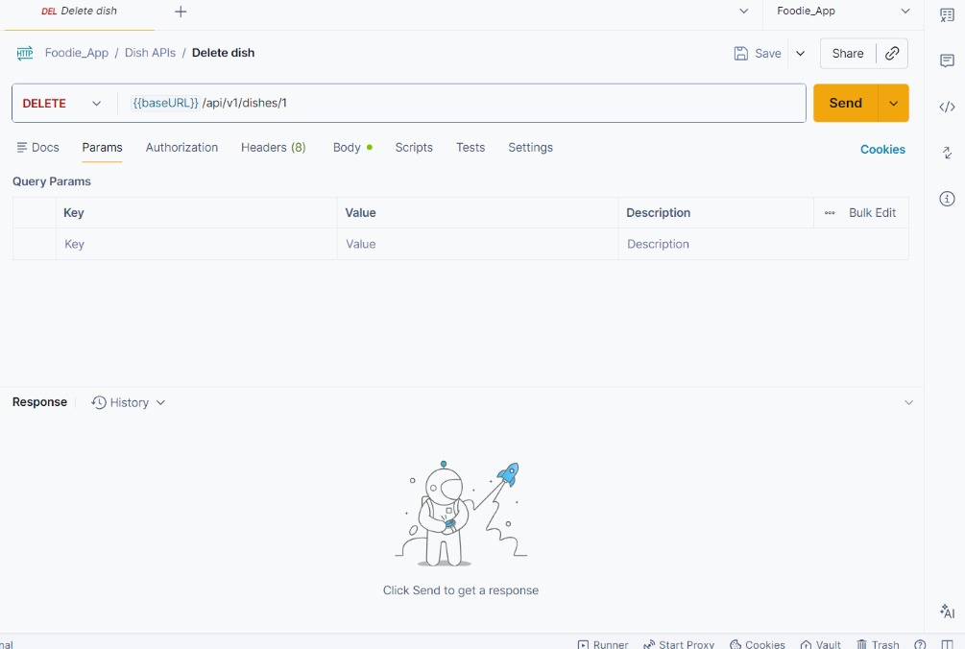
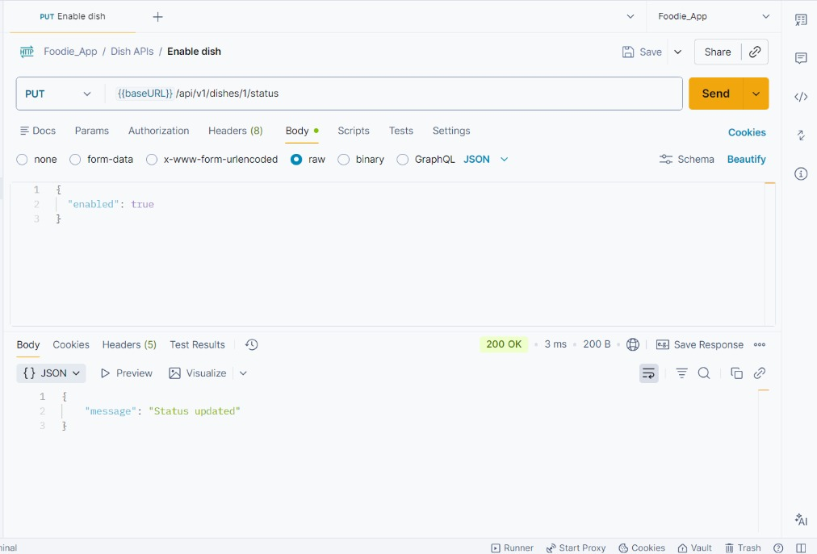
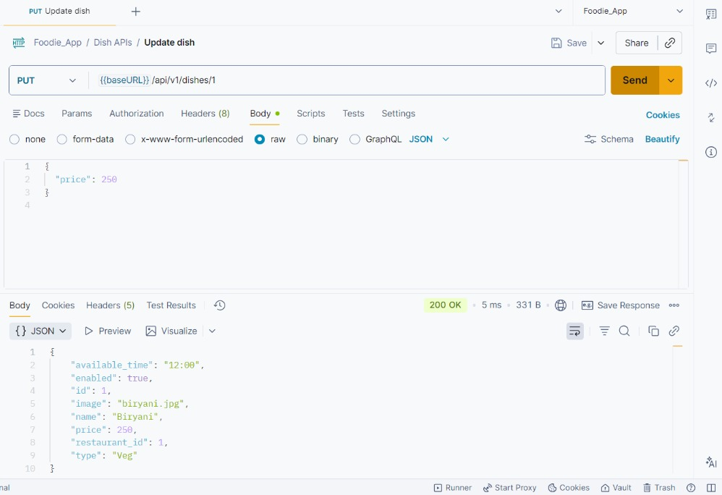
Add Dish
Delete Dish
Dish Api's
Enable Dish
Update Dish

Slide 14
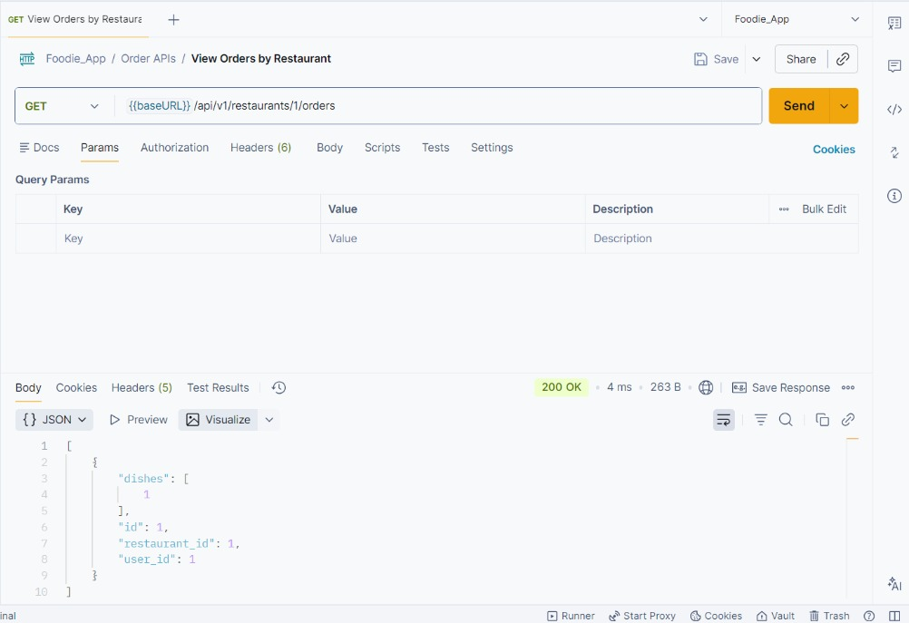
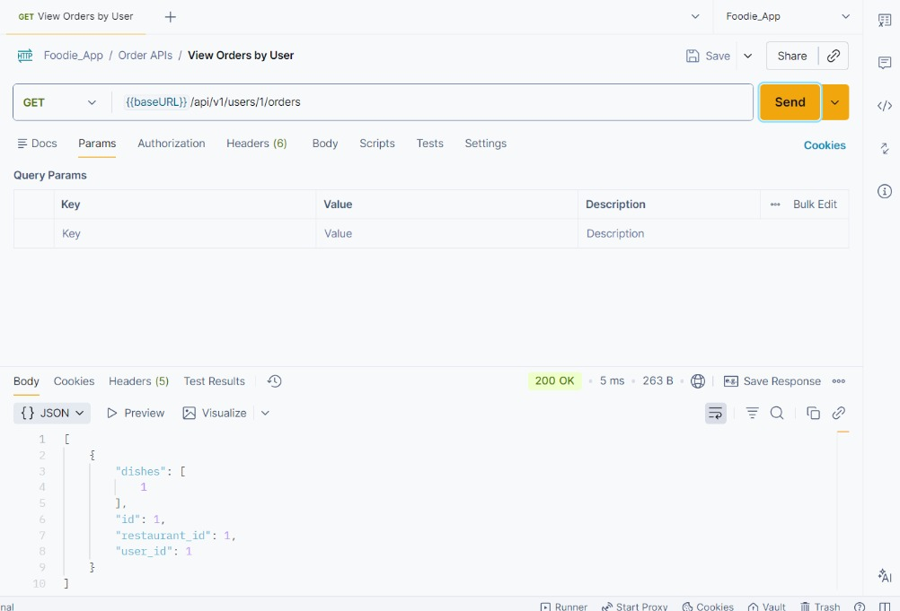
View Order by Restaurant
Order Api's
View Order by User

Slide 15
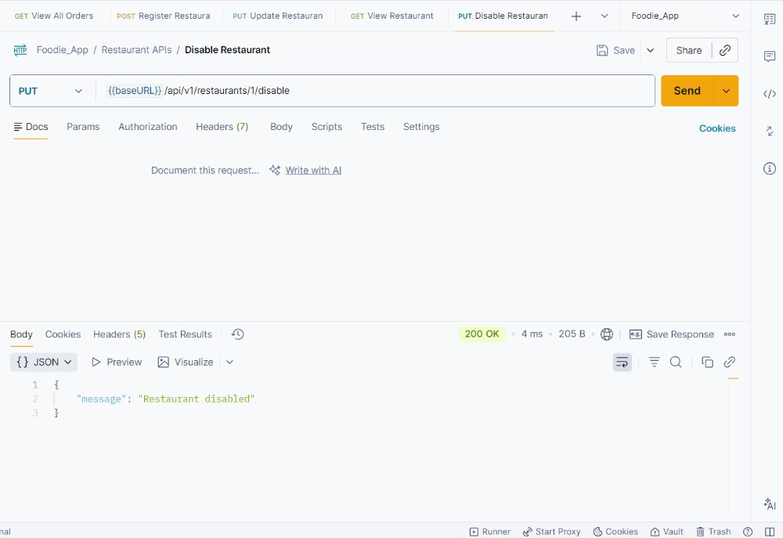
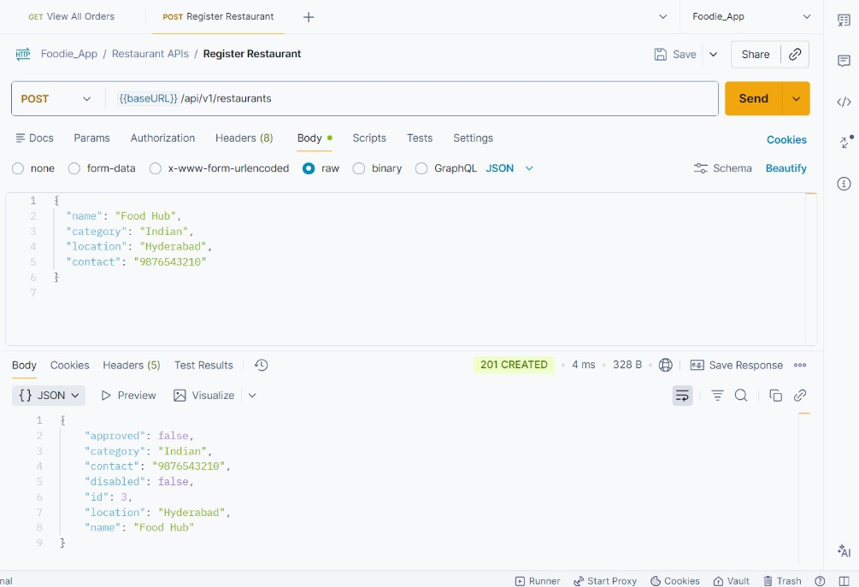
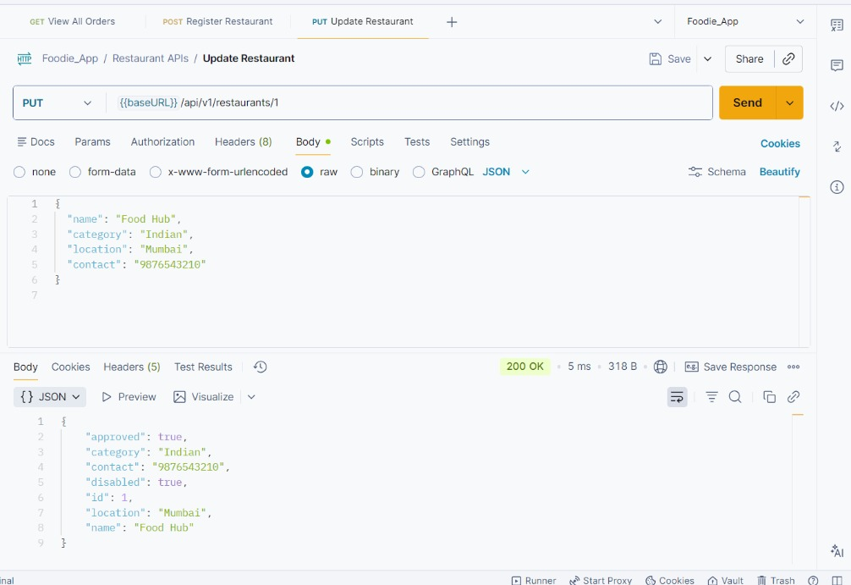
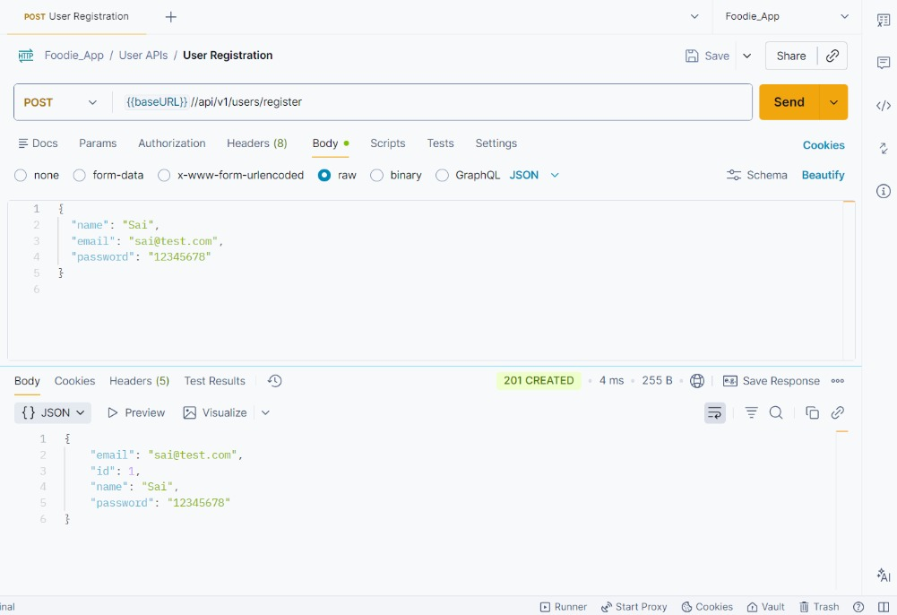
Disable Restaurant
Register Restaurant
Restaurant APi's
Update Restaurant
View Restaurant

Slide 16
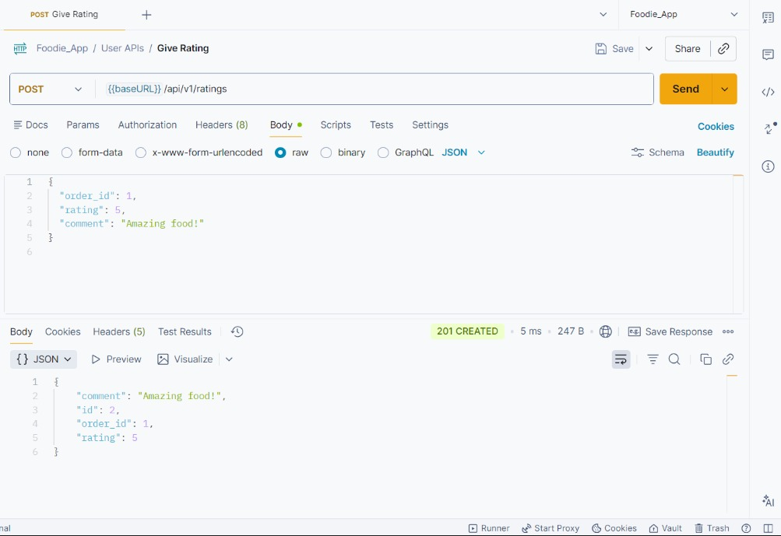
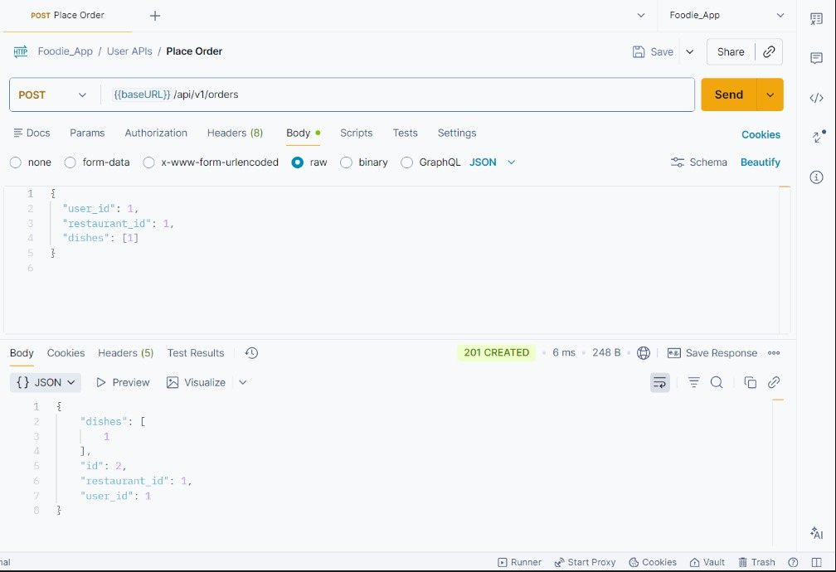
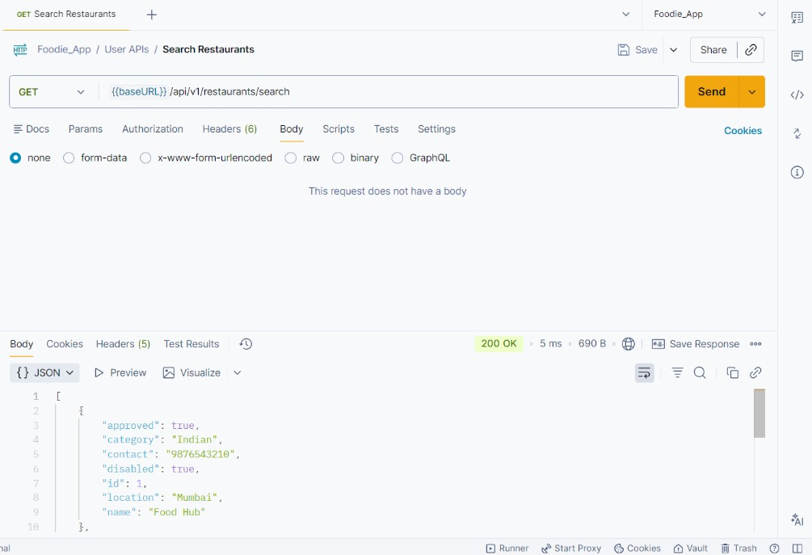
Give Rating
Place Order
User Api's
Search Restaurant
User Registration

Slide 17
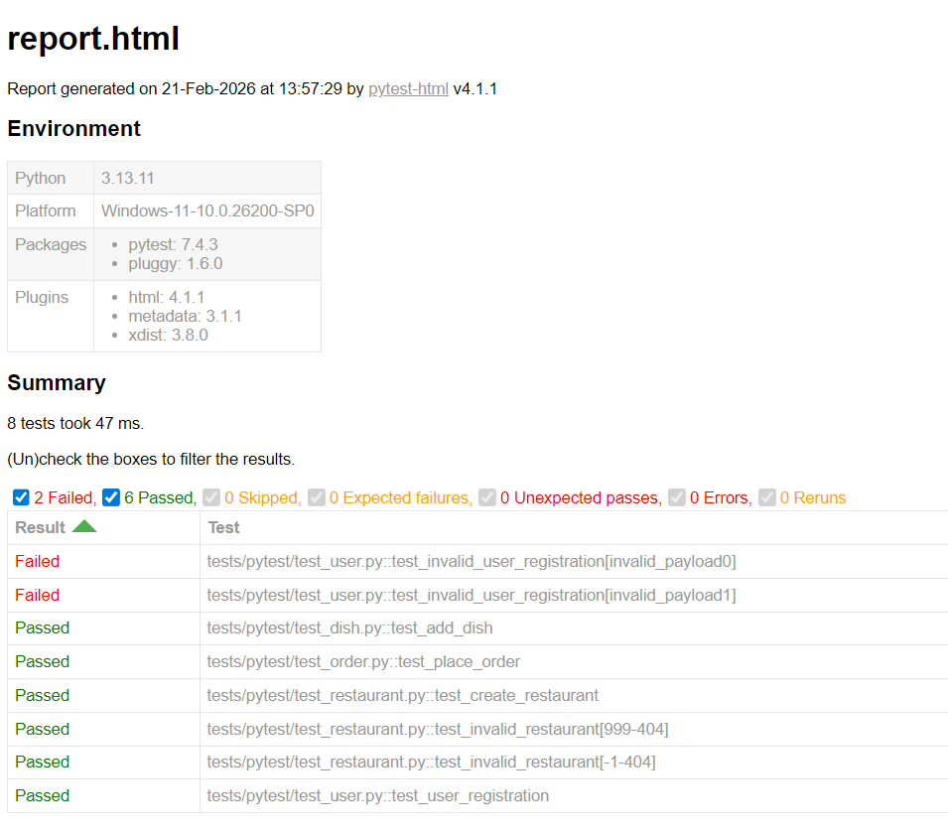
Pytest- Test Report

Slide 18
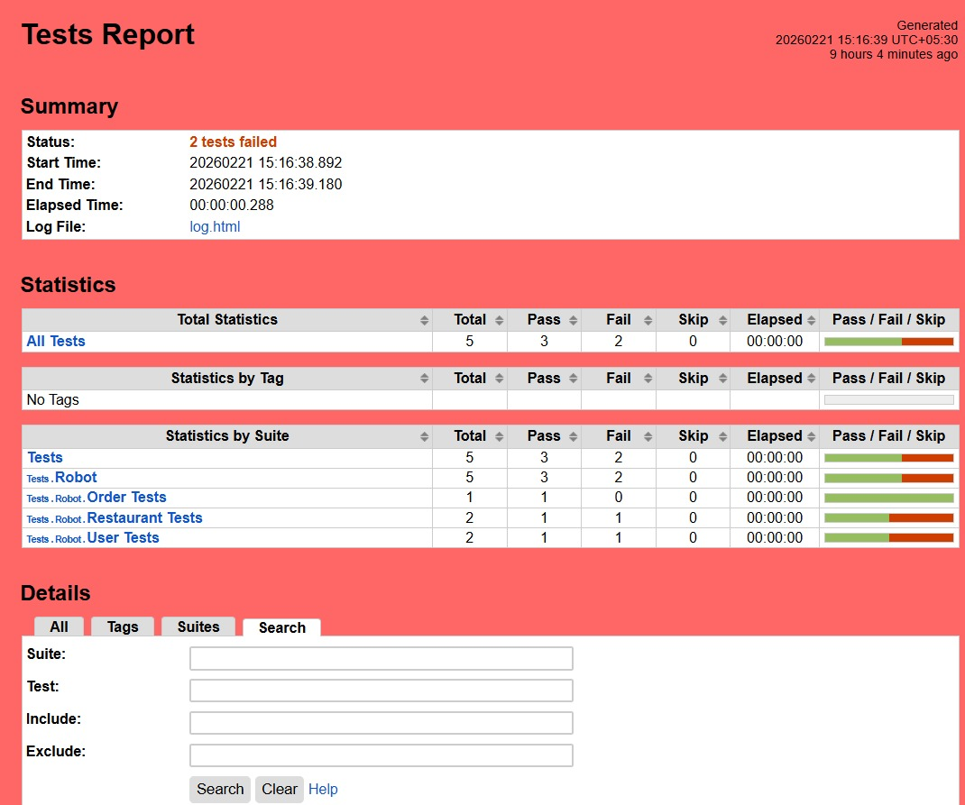
Robot- Test Report

Slide 19

E-Commerce: Selenium UI Automation
Dual-Framework Approach for Complete Test Coverage
Pytest Framework
Robot Framework
Modular page classes
Reusable locators
Developer-centric design
Parameterized tests
HTML reports
Keyword-driven approach
Business-readable syntax
Centralized variables
Non-technical friendly
Rich HTML logs
Both frameworks validate the complete e-commerce user journey

Slide 20
E-Commerce: Project Structure
Pytest Framework
Robot Framework
Pytest-framework/
├── pages/ (Page Object classes)
├── tests/ (Test cases)
├── data/ (Test data - JSON/CSV)
├── reports/ (HTML reports)
├── conftest.py (Fixtures)
└── requirements.txt
robot-framework/
├── keywords/ (Custom keywords)
├── tests/ (Robot test suites)
├── variables/ (Centralized variables)
├── reports/ (HTML reports)
└── requirements.txt

Slide 21
E-Commerce: Test Scenarios Covered
User Login (Valid & Invalid Credentials)
User Registration & Account Management
Product Search, Browsing & Filtering
Add to Cart & Remove from Cart
Complete Checkout Flow (End-to-End)
Form Validation (Positive & Negative Cases)
Navigation & UI Verification

Slide 22

E-Commerce: Pytest Page Object Model
Pytest Pages
LoginPage - Login interactions & locators
HomePage - Navigation & product browsing
CartPage - Cart operations
CheckoutPage - Payment & order completion
conftest.py - Fixtures & browser setup
test_*.py - Test cases with assertions

Slide 23
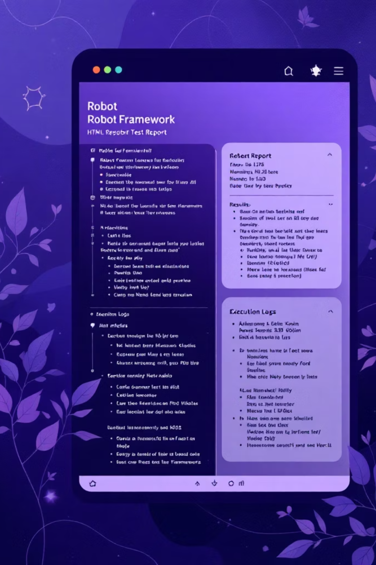
E-Commerce: Robot Framework Keyword-Driven
Keyword-Driven Architecture
common_keywords.robot - Reusable test steps
login_tests.robot - Login test scenarios
cart_tests.robot - Cart operation tests
checkout_tests.robot - Checkout flow tests
variables.py - Centralized URLs, credentials, selectors
Business-readable test syntax

Slide 24
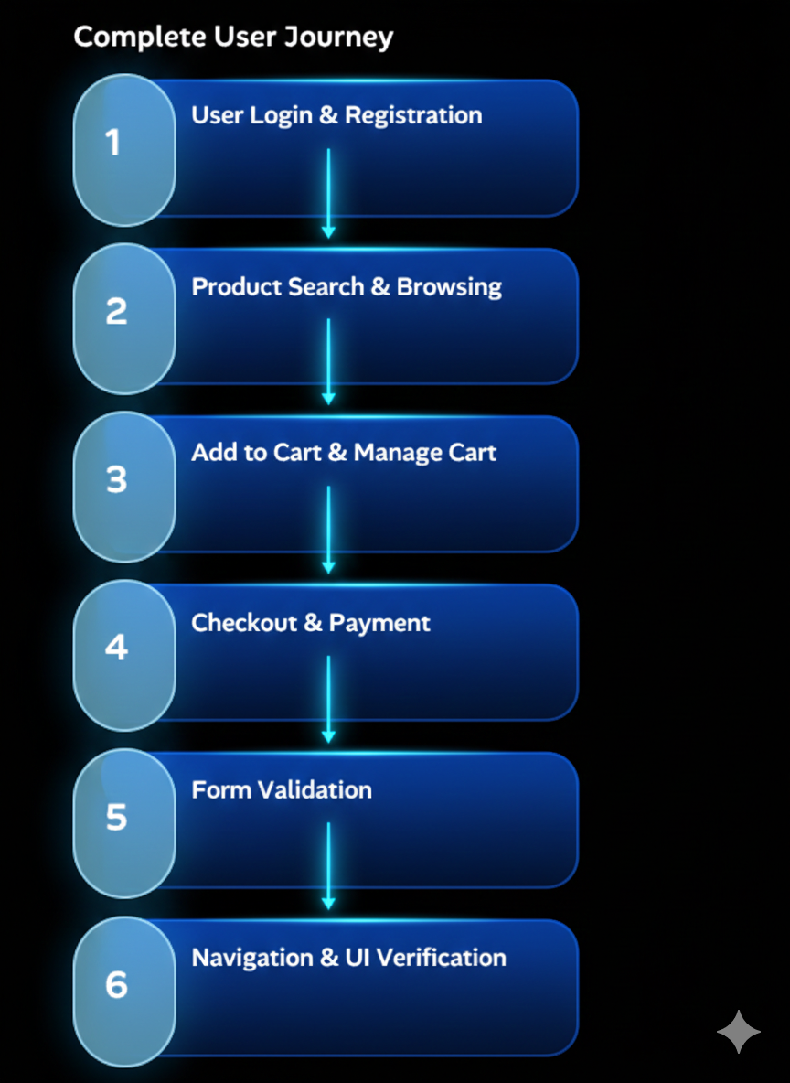
E-Commerce: Test Scenarios

Slide 25

Page Object Model (POM)
Selenium Best Practice
Simple explanation:
Page Classes:
Benefits:
LoginPage
HomePage
CartPage
CheckoutPage
✓ Centralized locators
✓ Easy updates
✓ Improved readability
✓ Reduced maintenance
Encapsulates page elements & interactions
Separates test logic from UI code
Easy to maintain & update
Reusable across tests

Slide 26
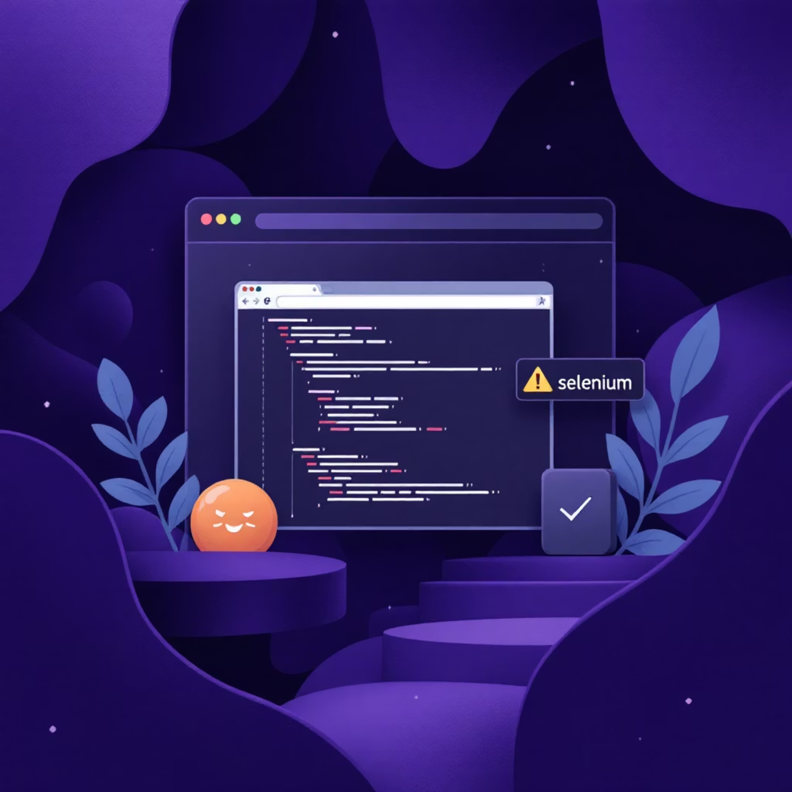
Selenium WebDriver
UI Automation Tool
Key Features
Multi-browser support (Chrome, Firefox, Edge)
Element interaction (click, type, select)
Waits & synchronization
Navigation & window management
Element locators (ID, CSS, XPath)
Assertions & verification

Slide 27
Pytest vs Robot Framework
Framework Comparison
Pytest
Robot Framework
Python-based
Developer-centric
Code-driven approach
Modular & reusable
Great for developers
Keyword-driven
Business-readable
Non-technical friendly
Easy to learn
Great for QA teams

Slide 28
Test Data Management
Data-Driven Testing
Data Sources:
Benefits:
✓ Single test covers multiple scenarios
✓ Easy to add new test cases
✓ Reduces code duplication
✓ Improves maintainability
JSON files (user credentials, product data)
CSV files (test scenarios, bulk data)
Excel files (complex test cases)

Slide 29
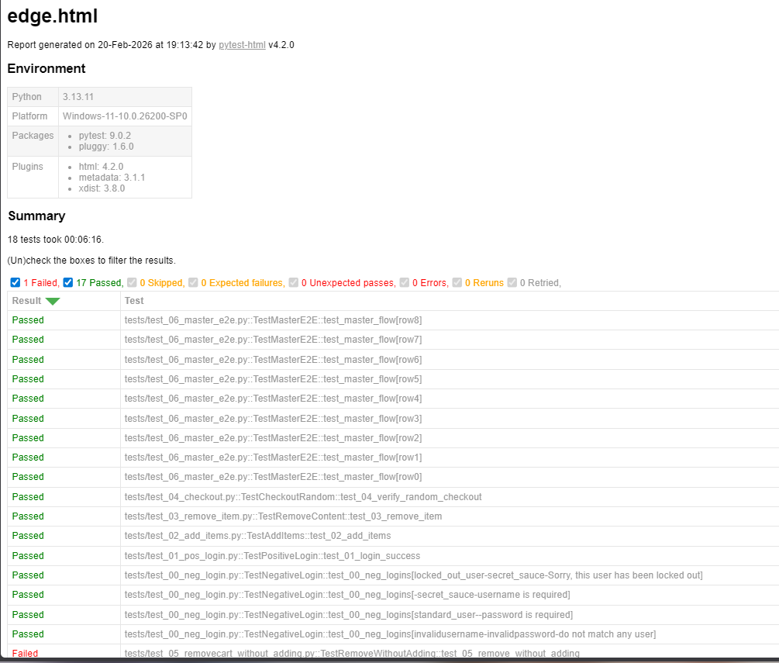
Pytest-Framework Test Report

Slide 30
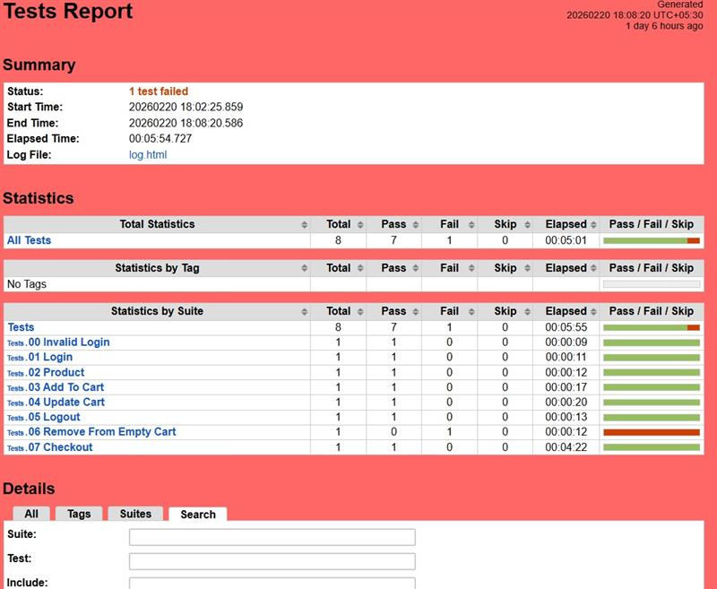
Robot- Test Report

Slide 31

Learning Outcomes
Skills Developed
REST API Testing:
Automation Frameworks:
✓ API design principles
✓ HTTP methods & status codes
✓ Request/response validation
✓ Error handling
✓ Pytest & Robot Framework
✓ Parameterized testing
✓ Test organization
✓ Report generation
UI Automation:
✓ Selenium WebDriver
✓ Page Object Model
✓ Cross-browser testing
✓ Element locators

Slide 32
Key Achievements
Project Highlights
Foodie App:
E-Commerce:
Combined:
✓ 18 API endpoints tested
✓ 5 functional modules
✓ 10+ test cases (Pytest + Robot)
✓ 100% API coverage
✓ 10+ test scenarios
✓ 4-page object classes
✓ 10+ test cases
✓ Complete user journey
✓ 2 complete projects
✓ 1000+ lines of test code
✓ 6 team members
✓ Enterprise-grade quality

Slide 33

Technology Stack
Tools & Frameworks
Programming:
UI Automation:
Testing & Reporting:
Python 3.8+
Pytest 7.0+
Robot Framework 6.0+
Flask
Selenium WebDriver 4.0+
ChromeDriver
GeckoDriver
Postman
pytest-html
Robot HTML Reports

Slide 34
Best Practices
Quality Assurance Standards
Code Quality:
Testing:
Collaboration:
✓ Clean code principles
✓ DRY (Don't Repeat Yourself)
✓ Meaningful naming
✓ Documentation
✓ Test independence
✓ Comprehensive coverage
✓ Positive & negative cases
✓ Edge case handling
✓ Code reviews
✓ Version control
✓ Team communication
✓ Knowledge sharing

Slide 35

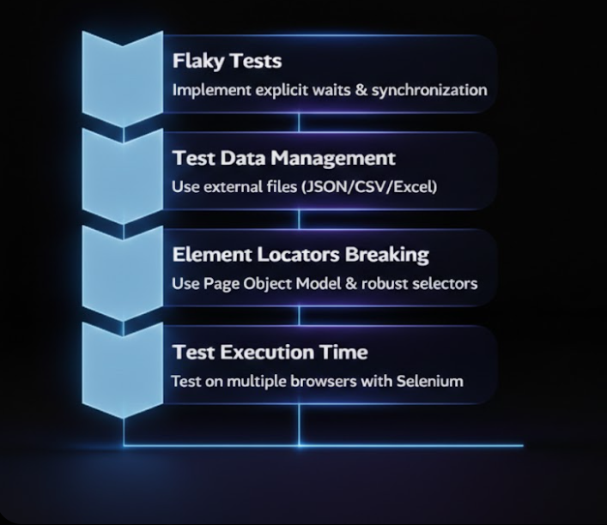
Challenges & Solutions
Real-World Problem Solving

Slide 36
Getting Started
Quick Setup
Prerequisites:
Setup Steps:
Python 3.8+
Git
Chrome/Firefox browser
ChromeDriver/GeckoDriver
Clone repository
Create virtual environment
Install dependencies
Run tests
Commands:
pytest -v
robot tests/

Slide 37




Key Takeaways
What We've Learned
Dual-Framework Mastery
Enterprise Architecture
Pytest for developers
Robot Framework for QA teams
Both provide comprehensive coverage
Layered design
Page Object Model
Clean code principles
Complete Testing
Professional Quality
API testing (Foodie App)
UI testing (E-Commerce)
End-to-end coverage
Best practices
Continuous improvement

Slide 38
Project Architecture Comparison
Pytest Page Object Model
Robot Keyword-Driven
Tests Layer: test_login.py, test_cart.py with assertions
Tests Layer: login_tests.robot with readable scenarios
Keywords Layer: common_keywords.robot reusable steps
Pages Layer: LoginPage, CartPage with locators and actions
Variables Layer: Centralised URLs, credentials, selectors
Data Layer: JSON, CSV, Excel external test data
One-place locator updates, clean separation of concerns
Non-technical stakeholders can read and understand tests

Slide 39






Meet the Team
Wipro Training Group 5 — Capstone Project
Six dedicated engineers bringing automation testing excellence to life
Sai Prakash Reddy
Prashant Kumar Jha
Bhagyashree N
Chowdam Mahendra
Praseed Sreepadmakumar
Ravinesh Tiwari

Slide 40

WIPRO TRAINING — GROUP 5
Thank You
From REST API validation across 18 endpoints to dual-framework UI testing with both Pytest Page Object Model and Robot Framework — our team delivered enterprise-grade quality assurance from end to end. This capstone represents not just working test suites, but a foundation of collaborative excellence, technical depth, and real-world engineering discipline.
2
18
6
2
Complete Projects
API Endpoints
Team Members
Dual Frameworks
API & UI Testing
Fully Tested
Wipro Group 5
Pytest POM & Robot

